Slide 1
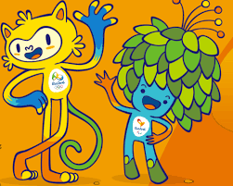
Questions considered about the 2016 Summer Olympics in Rio de Janeiro, Brazil.
Was Brazil’s economy affected by hosting the 2016 Summer Olympics in Rio de Janeiro?
Was Brazil’s economy better or worse from hosting the 2016 Summer Olympics in Rio de Janeiro?
In this study, we used economic data from two countries that hosted the Summer Olympics as controls: Greece (2004) and the United Kingdom (2012)

Slide 2
What is GDP and why is it an important metric?
Gross Domestic Product or GDP is an important metric that can help policy makers and economists determine the overall health of a nation’s production and growth.
Positive GDP growth in a country is a sign that unemployment is lower; wages are growing; and demand for products and services has increased.
Negative GDP growth means that the country is heading towards a slowing in their economy and that a recession is approaching.

Slide 3
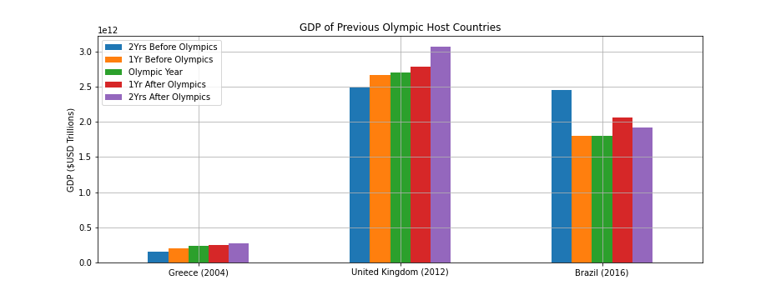
Annual GDP for Brazil
Control Countries: Greece and the United Kingdom (UK)
Greece and the UK trend upward in GDP pre and post Olympic
Brazil’s GDP dropped 26.6% in 2015, but increased 14.9% in 2017
Source: The World Bank API

Slide 4
What is GDP per capita?
Gross Domestic Product (GDP) per capita is equal to the country’s GDP divided by its overall population. This metric gauges the prosperity of the country based on its economic growth and often measured along with a country’s GDP.
GDP per capita shows how much each individual citizen contributes to the value of a country’s production (i.e. the production of goods and services).

Slide 5
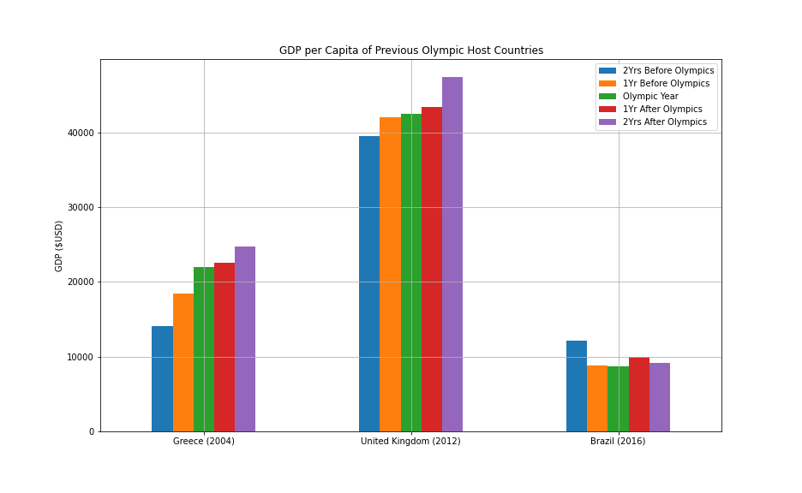
Annual GDP per Capita for Brazil
Brazil shows a decline of 27.2% in per capita GDP leading up to and after the Rio Summer Olympics, but increased 14% in 2017.
Other nations trends upwards in their per capita GDP after the Summer Olympics.
Source: The World Bank API

Slide 6
What is Consumer Price Inflation or Consumer Price Index (CPI)?
Consumer Price Inflation tracks the change in retail prices of goods and services that is consumed on a daily basis.
Consumer Price Inflation is used to identify periods of inflation and deflation. It is often compared to the Producer Price Index (PPI), but is a good metric to see how an individual’s purchasing power has increased or declined over time.
A general sense is that a rise in the level of prices may influence how the government of the country decides on their economic and monetary policies.

Slide 7
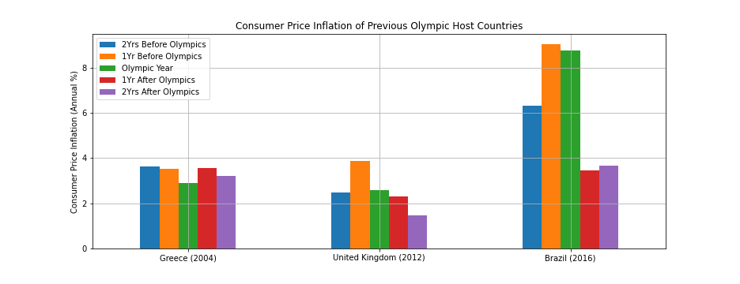
Consumer Price Inflation for Brazil
Inflation decreased for the fiscal year of each nation during the Summer Olympic games. Greece declined 0.63%; UK declined 1.28%; and Brazil declined 0.29%
Brazil had the most dramatic decrease in inflation the year after the Summer Olympic games at 5.29%
Source: The World Bank API

Slide 8
What is Industry Added Value?
Industry added value measures how much industry and a country’s government contribute to a country’s GDP.
Industry added value takes into account the overall cost of business (employee compensation, taxes, production costs, etc...) in the calculation of Industry Added Value.
An increase in the Industry Added Value helps economists and policy makers to measure the overall health business and governments are contributing to the economic health of a country. The data business and governments receive can help them make adjust or make policy changes.

Slide 9
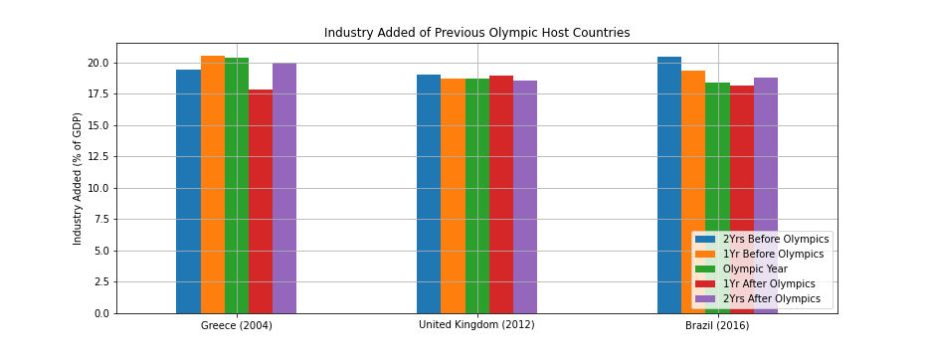
Industry Added Value for Brazil
All nations experienced some decline in added value from industry the year leading up to hosting the Summer Olympics.
Brazil experienced a decline in industry value added two years prior to the hosting the Summer Olympics (-1.11% in 2015 & -1.01% in 2016) and a year after hosting the Summer Olympics.
Source: The World Bank API

Slide 10
Analysis on how hosting the Summer Olympics affected Brazil.
The 2016 Summer Olympics in Rio de Janeiro had some positive effects on the overall economy in Brazil.
Brazil’s GDP improved dramatically the year after the Olympics. Other host countries saw modest gains in GDP.
Citizens of Brazil saw their personal wealth increase after the Summer Olympics in Rio, but the increase was temporary.
Brazil’s inflation was brought down during the Summer Olympics and saw a dramatic decrease in the year after the Olympics in Rio.
The industrial and government sector didn’t seem to add much value to the overall GDP of Brazil.
Overall, any positive economic effect from Brazil hosting the Summer Olympics was only temporary. Any lasting effects in the economy must come from fiscal and monetary policy decisions made by the Brazilian government. Hosting the Olympics plays a small and temporary effect in their economy.

